Slide 1
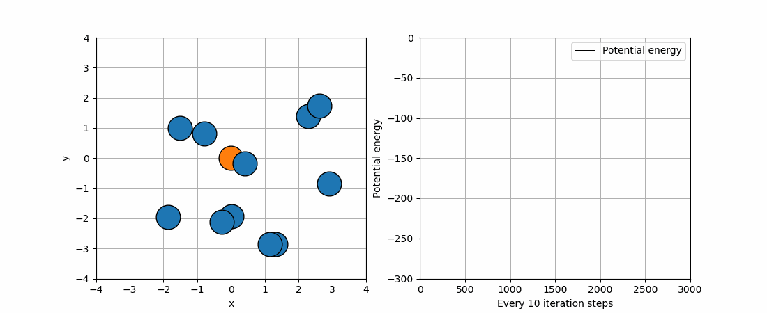
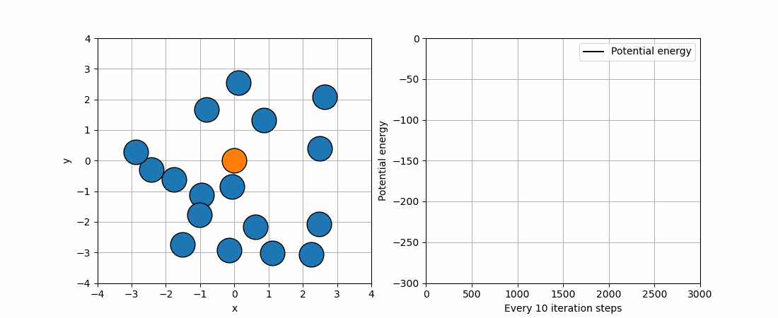
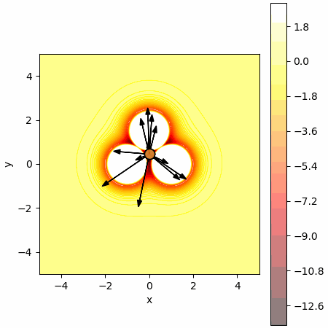
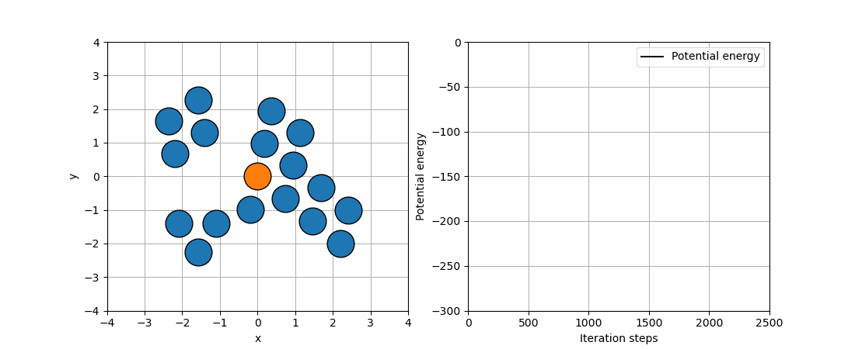
Optimization

Slide 2
Outline
Goal: Understand typical optimization problems & usages
Focus on finding lowest energy structures
Methods for solving optimization problems
Discuss their workings & limitations

Slide 3
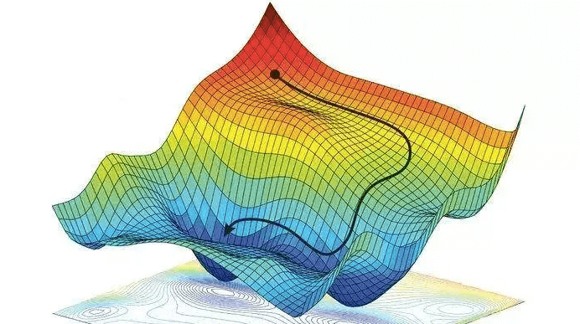
The optimization problem
Finding best solution → Minimizing some loss in terms of some paramters
Hard problem → Few cases analytic
Doing gradient descent
Evaluation of gradient
Stuck

Slide 4
Exercises 11 – 17: Find lowest energy structures
Collection of atoms in LennardJones
First method: Metropolis Montecarlo
Temperature dependent

Slide 5
Exercises 11 – 17: Find lowest energy structures
Second method: Gradient based optimization
Line-search → Stuck
Solution: Bassin Hopping

Slide 6
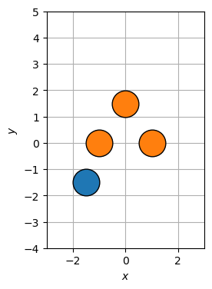
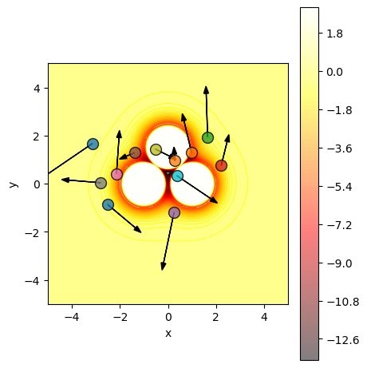
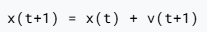
Another approach: Exercise 16 – PSO
Particle Swarm Optimization
Each particle →Atomic configuration
Update particle positions and velocities:

Slide 7
Another approach: Exercise 16 – PSO

Slide 8
Another approach: Autodifferentiation
Work around using finite difference
MAYBE DROP THIS SLIDE

Slide 9
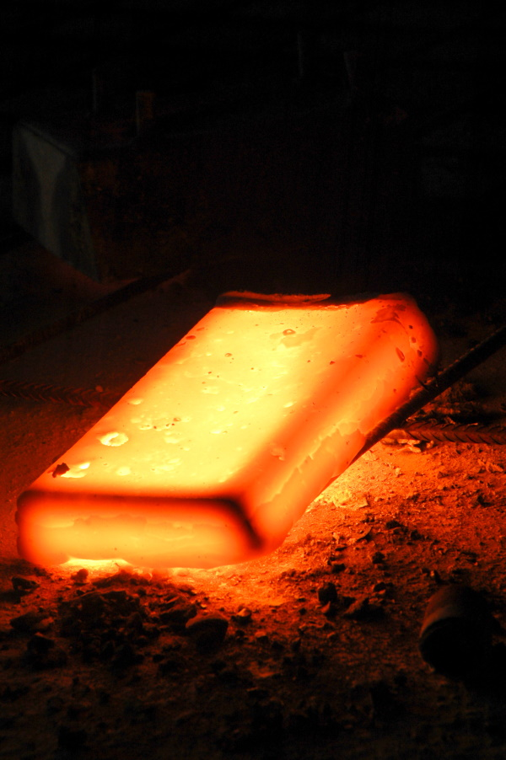
Yet another approach: Exercise 28 – Simulated annealing
Real world → Use MD-simulation
Set up relaxed atoms → Heat up → Cool down (slowly)
Hopefully end up in more stable structure

Slide 10
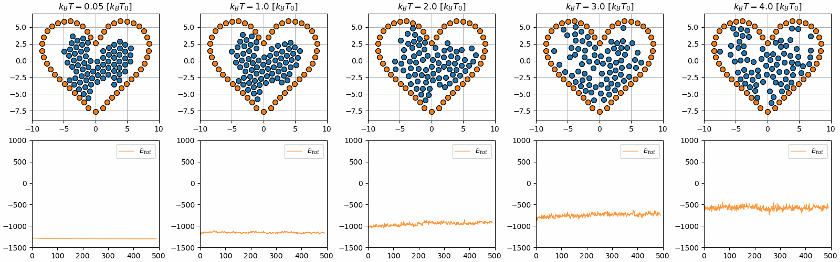
Yet another approach: Exercise 28 – Simulated annealing
Set up relaxed atoms → Heat up → Cool down (slowly)
Hopefully end up in more stable structure

Slide 11
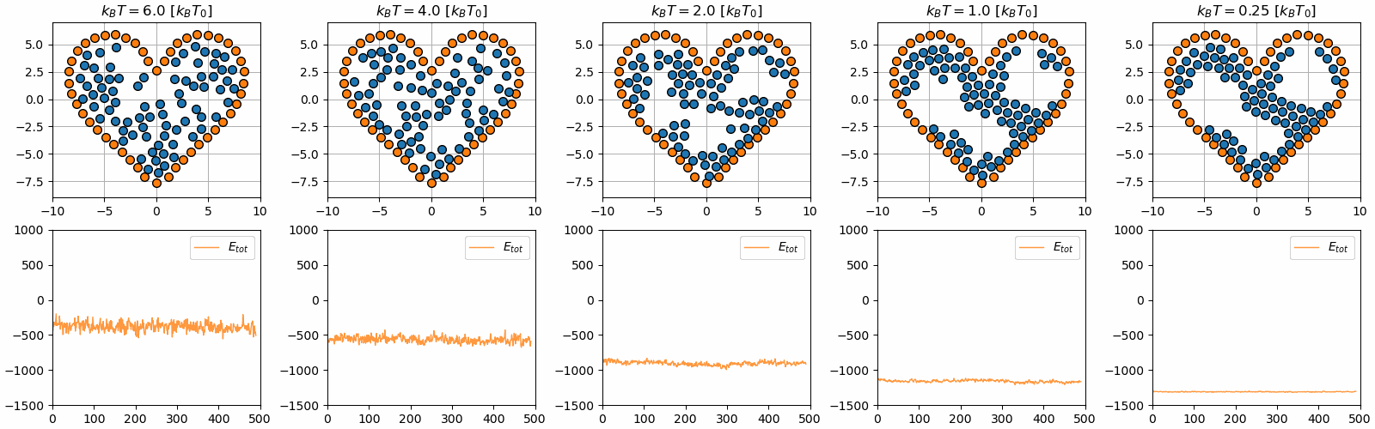

Slide 12
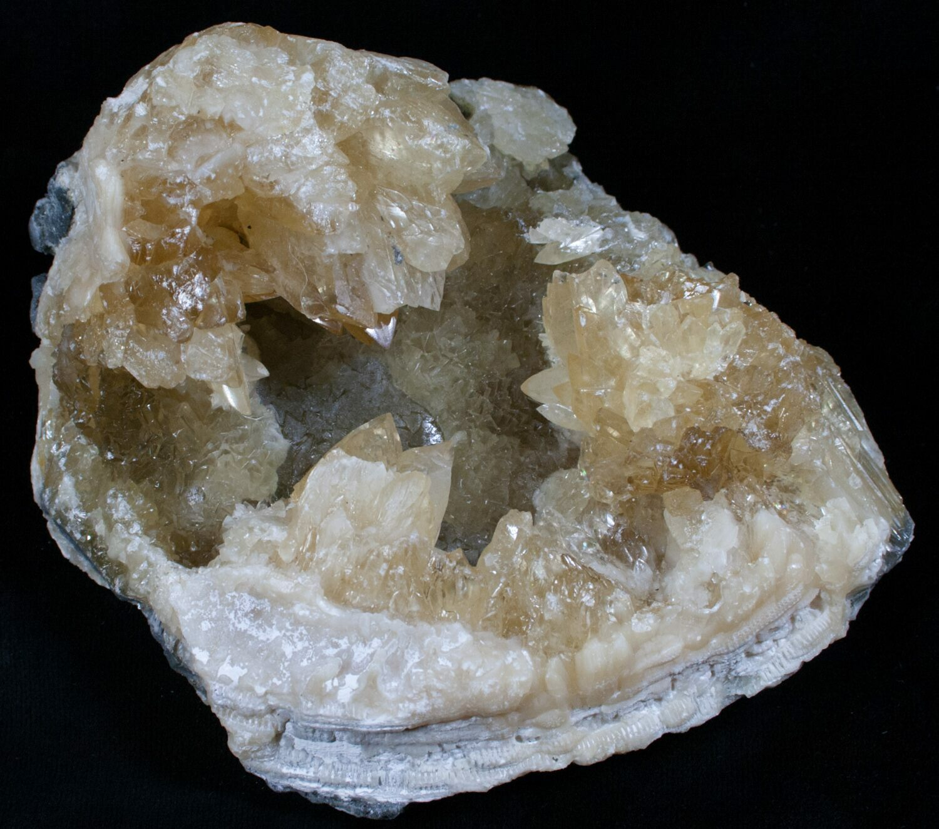
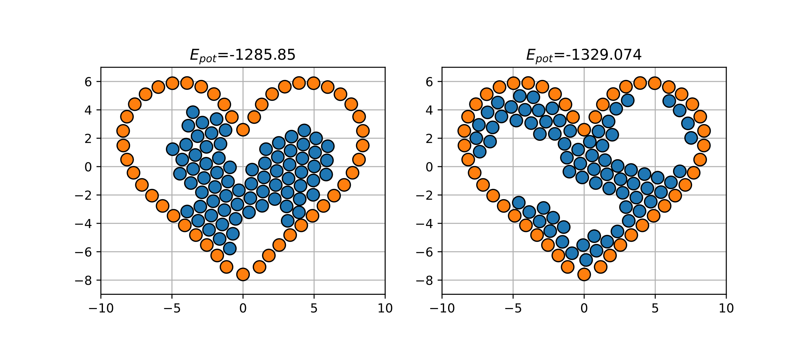
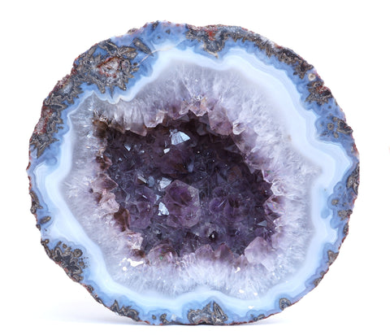
Exercise 28 – Simulated annealing
Finite simulation time

